Slide 1

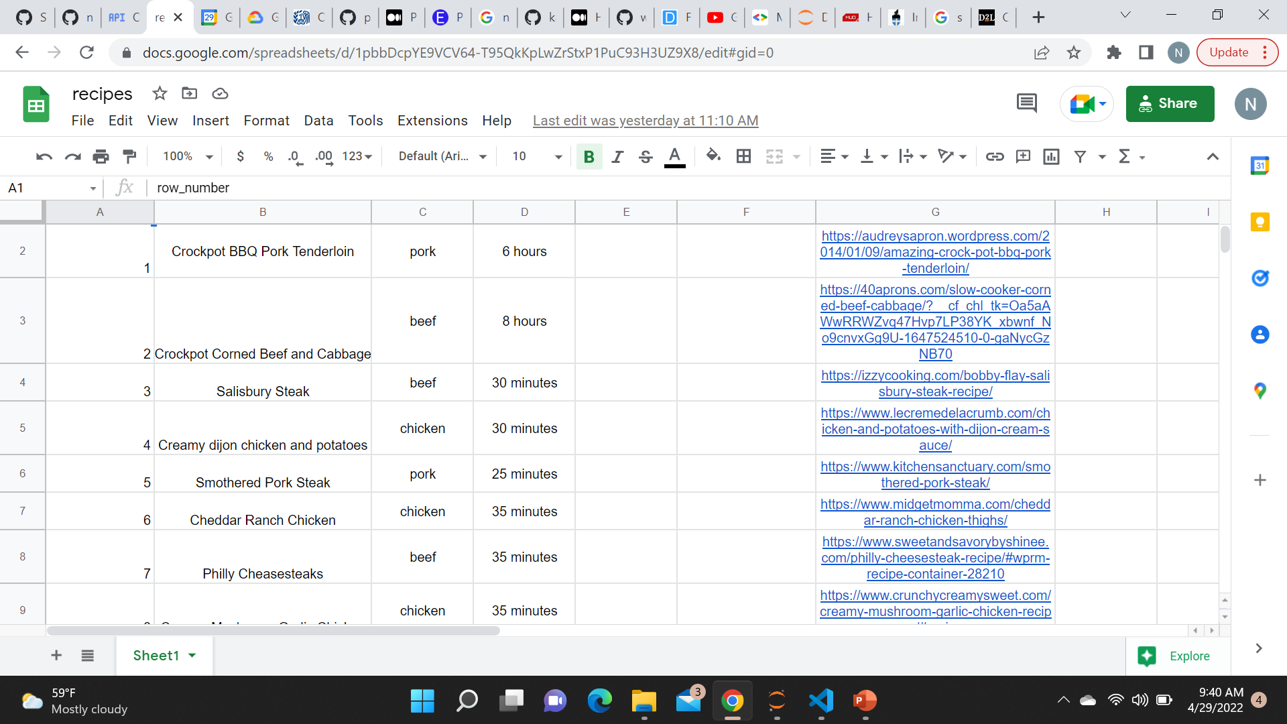

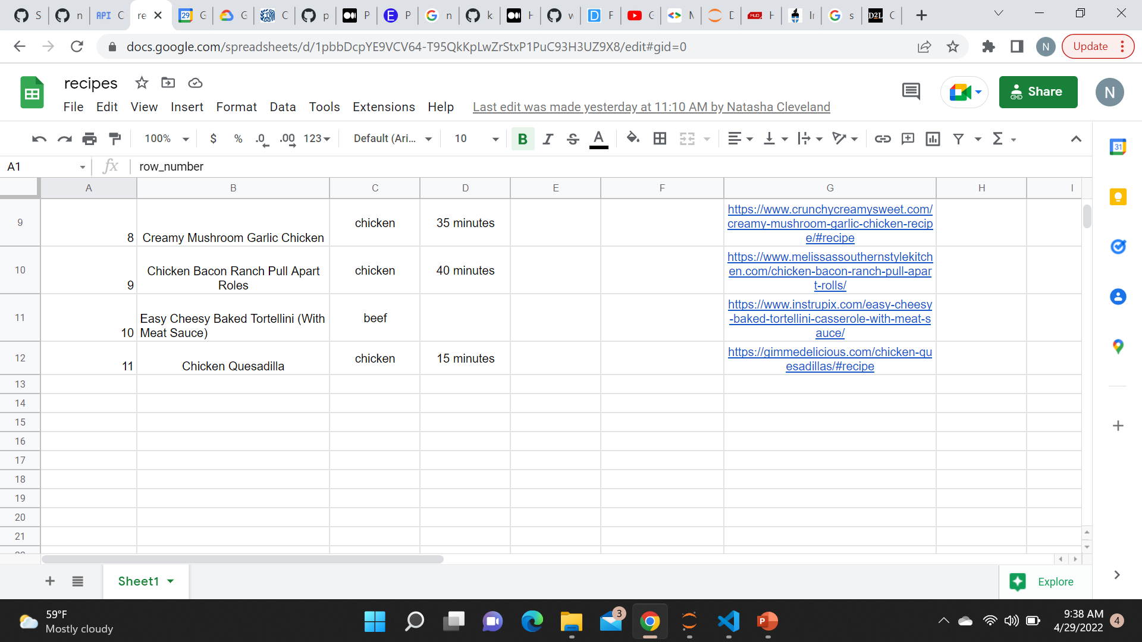
Meal Planner App
The Meal Planner App maintains a database of recipes that the user can add to at anytime. When it’s time for them to plan meals for the week, they can pull recipes from the database onto a separate spreadsheet based on their search.
Coder:
Natasha Cleveland
This Photo by Unknown Author is licensed under CC BY-ND

